Slide 1
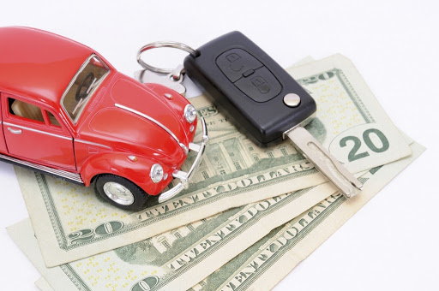
CAR PRICE PREDICTION
By Spandana, Madhu, Sudharshan, Divya

Slide 2
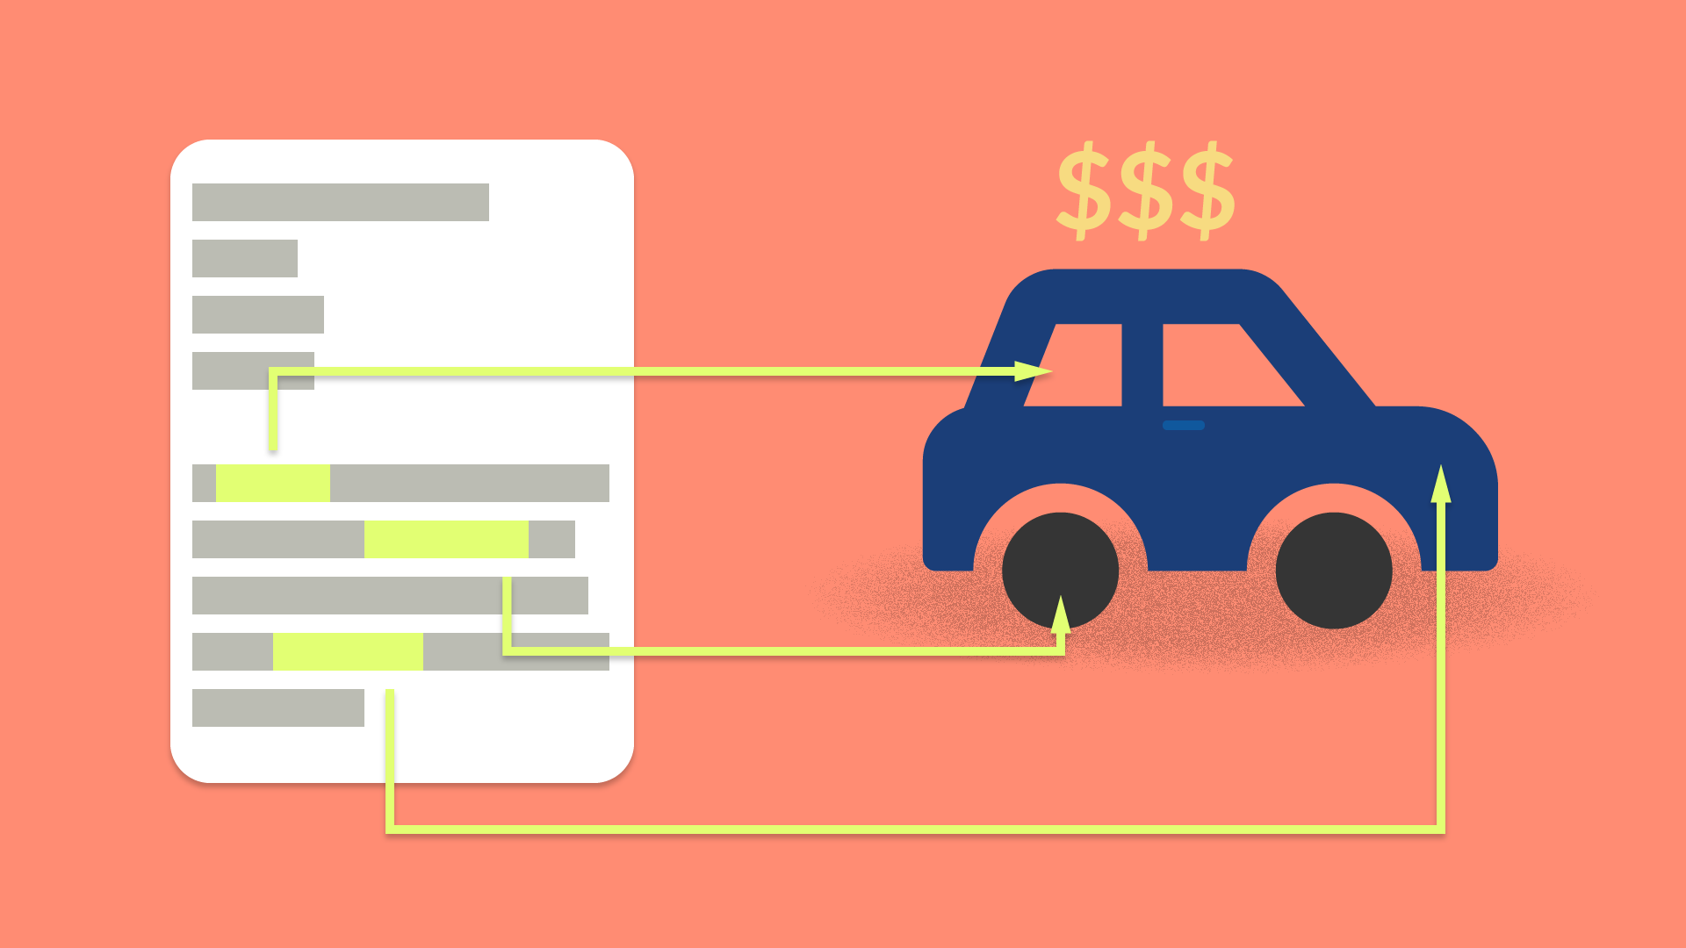
Motivation
“Autos sales” is one of the major producers of domestic automobiles report sales.
Car price prediction especially when the car is used and not coming direct from the factory, is both a critical and important task.
There is a need of accurate price prediction mechanism for the used cars which can express the changes in economy precisely.
Prediction techniques of machine learning can be helpful in this regard.
It is common to lease a car in many countries rather then buying a new car.
Notes:
Domain: healthcare
Relatable to all of us

Slide 3
Objectives
The main objective of our project is to predict the price of the used car data.
To compare the difference between the actual price and predicted price.
Using this difference, to improve our model close enough to the actual model.

Slide 4
Dataset
Source of data : https://www.kaggle.com/orgesleka/used-cars-database
Datapoints: 370000
Years : 2016
Notes:
Easy navigate UI
Active community
Terms and conditions: not for commercial use, not disrupting traffic

Slide 5
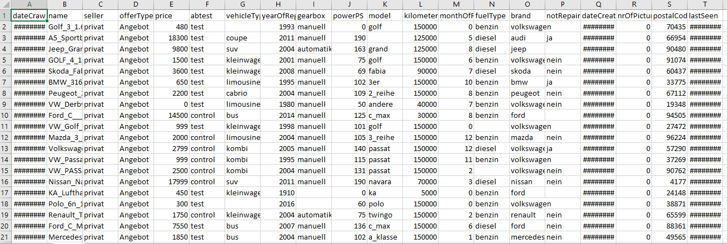
Dataset

Slide 6

Data Cleansing
Reformatted existing columns foe easier analysis.
NaN, space values filled with mean, median and mode.
Conversion of few columns to datetime and integer values as needed for analysis.

Slide 7
Models Used
Linear Regression Model
K_Nearest Neighbors
Artificial Neural Network – MLP Regressor
Decision Tree Model
Random Forest Model
Notes:
Title, author, content, replies

Slide 8
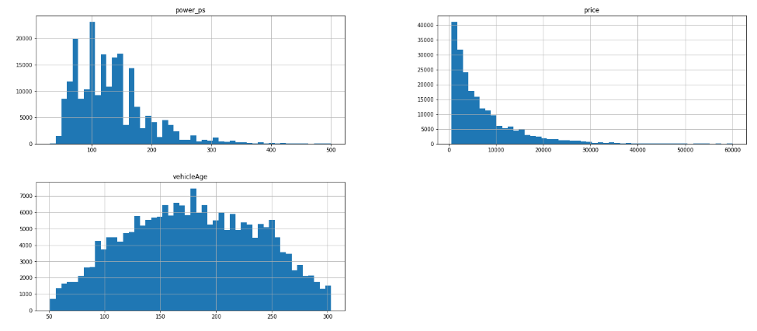
Exploratory Data Analysis
Price outliers Price >= 600 and Price <= 60000
Registration Year Year >=1995 and Year <=2015
Power_pS Power_ps >=30 and Power_ps <=500
VehicleAge

Slide 9
Methodology
Dataset from Kaggle
Data Cleansing
EDA
Visualizations
Models

Slide 10
Training Set and Test Set
Data has been divided into training and test data.
70% of train data
30% of test data
Notes:
Html tree

Slide 11
Summaries of Training and Test Data
Notes:
A web crawler (also known as a web spider or web robot) is a program or automated script which browses the World Wide Web in a methodical, automated manner. This process is called Web crawling or spidering. Many legitimate sites, in particular search engines, use spidering as a means of providing up-to-date data.

Slide 12
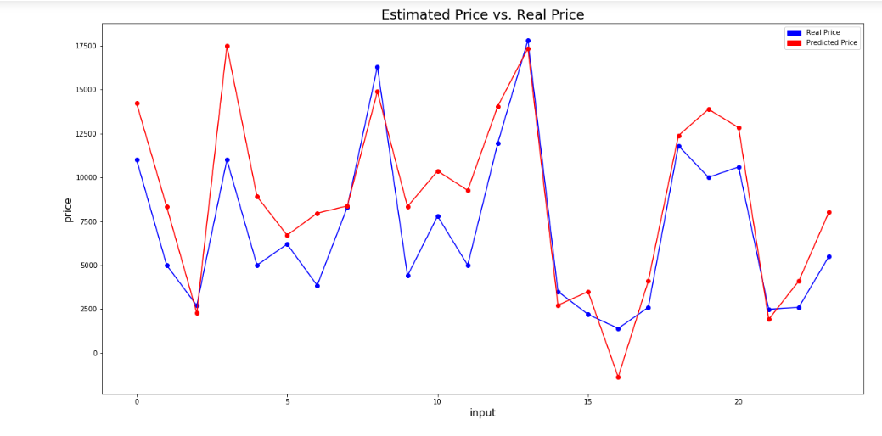
Linear Regression Model

Slide 13
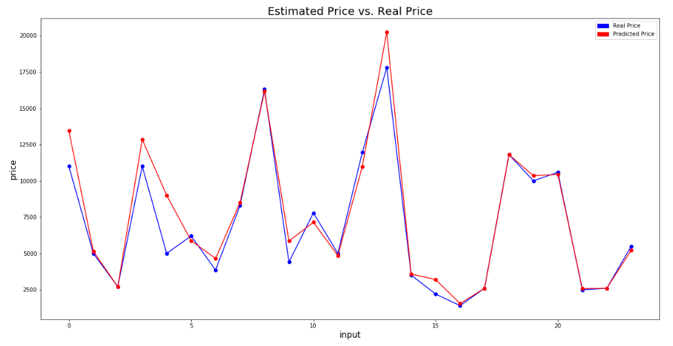
K-Nearest Neighbors

Slide 14
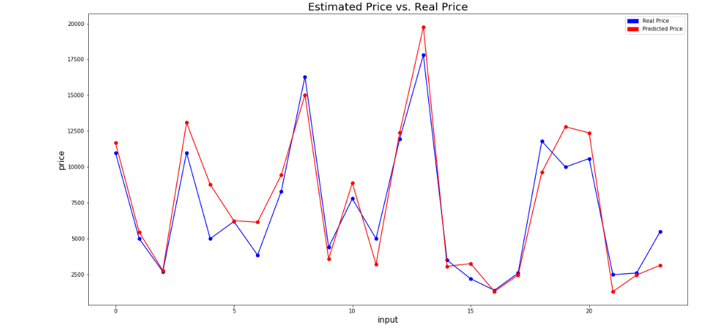
Artificial Neural Network – MLP Regressor
Notes:
BAT File: execute commands with the Windows Command Prompt

Slide 15
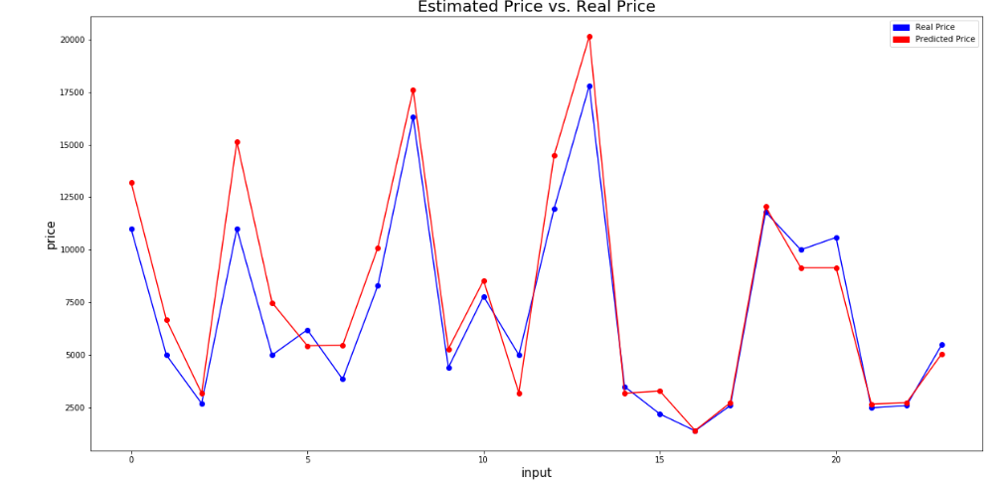
Decision Tree

Slide 16
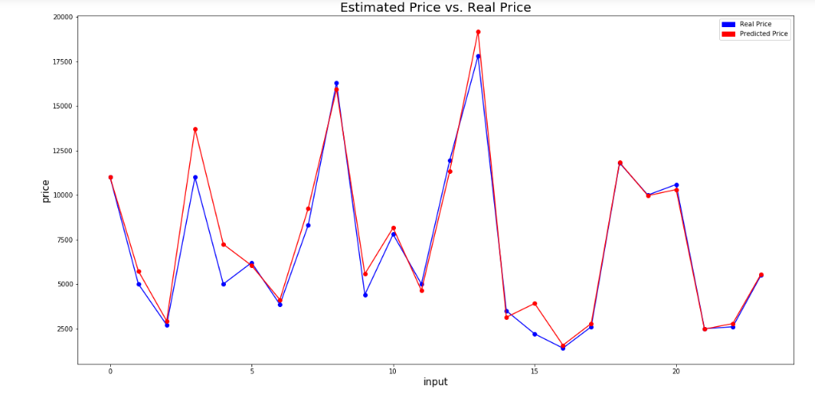
Random Forest Model

Slide 17
Potential Uses and Application
Developing countries adopt lease culture instead of buying a car due to affordability.
There is a need for a used car price prediction system to effectively determine the worthiness of the car using a variety of features.

Slide 18
Summary/ Conclusion
We evaluated used-car price prediction using Kaggle dataset which gives an accuracy of 93% with RandomForest Model.
The most relevant features used for this prediction are price, year, Power_ps, and vehicleAge by filtering out outliers and irrelevant features of the dataset.
This model gives us good accuracy when compared to the other models.

Slide 19
Further Improvement
To collect data for more cars
More information of cars in the current dataset
To adjust model hyperparameters, by using RandomizedSearchCV
https://scikit-learn.org/stable/modules/generated/sklearn.model_selection.RandomizedSearchCV.html

Slide 20


